Slide 1

MAA02
AI IN THE BUILT ENVIRONMENT
2022/2023
SENIOR FACULTY ANGELOS CHRONIS, SERJOSCHA DUERING
STUDENTS ALEX FERRAGU, AKSHAY MADAPURA, ALESSANDRA WEISS, YUE WU

Slide 2
CONTEXT
Natalia wants to find a zany and artistic place somewhere in the city for a raucous Friday night with his friends. But he doesn’t know how to search in google map, and it doesn’t give him a satisfied result to match his unique needs.
Pedro, recently broken up with his boyfriend and feeling a bit lonely, wants to go to a low-key, chill, but friendly environment where he can pour his heart out to the bartender.

Slide 3

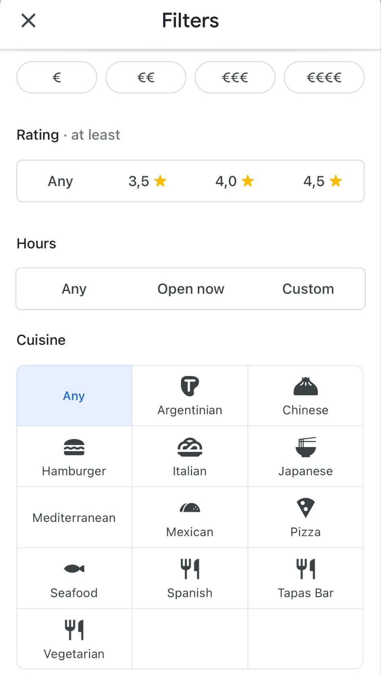
CONTEXT
When looking for a restaurant, current search methods are based on filters of factors like cost, rating, cuisine, etc. and limited to those.
Notes:
CONTEXT
(overview: why, what, how, where and for whom?)

Slide 4
PROBLEM STATEMENT
WHERE TO EAT
is rather a question of mood than a question of factors.
Notes:
Problem statement (which problem is solved, why are you solving it?)

Slide 5
What if restaurant searches could take into account a user’s moods or any other specific preferences using machine learning?
Notes:
CONTEXT
(overview: why, what, how, where and for whom?)

Slide 6
SOLUTION
MOODSAVOR
is an app that can take in whatever users’ needs in mind, helping them find the closest matching restaurants in Barcelona.

Slide 7
CONTEXT
Basic Concept:
GPT as data labeler (zero-shot multi-class prediction):
Bringing restaurant reviews and user moods into the same space.
KNN as a methodology to retrieve the restaurants that best match the user’s mood.
Notes:
No training data, predicting yes or no for each vibes

Slide 8
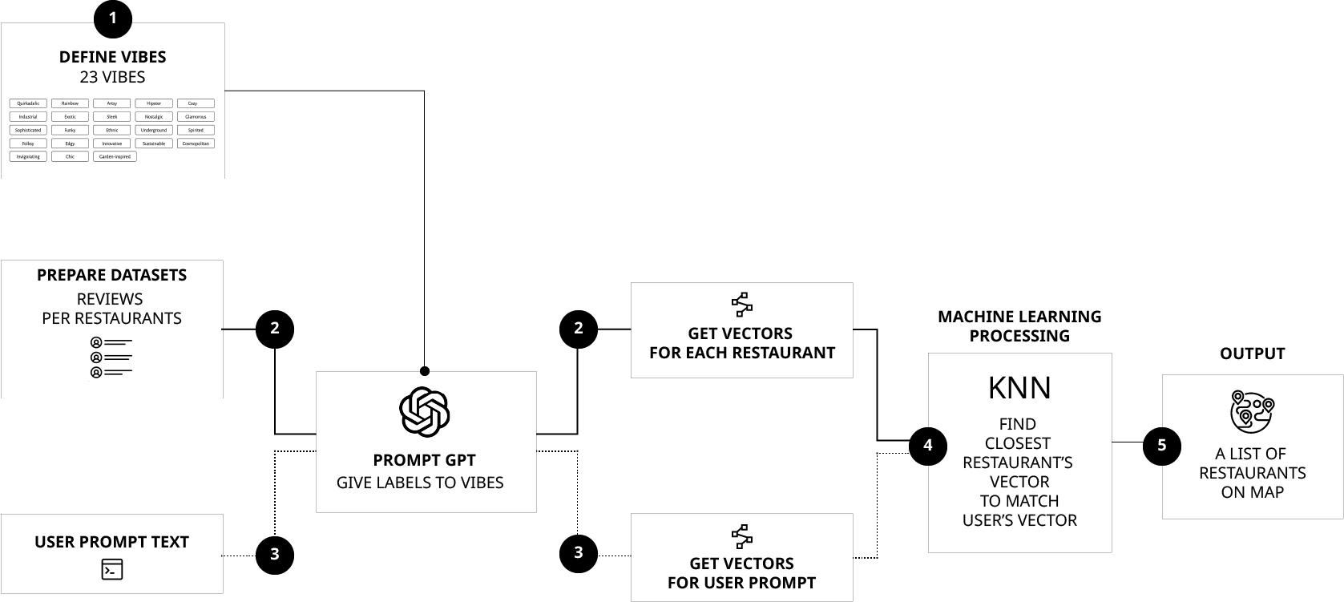
METHOD
Notes:
Method (how are you solving the problem?)
• including method flow-chart

Slide 9
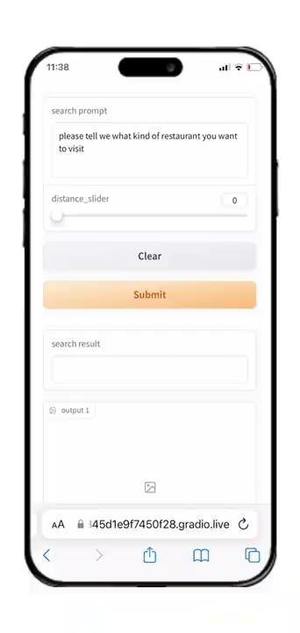
USER STORIES + DEMO
Pedro had a rough day at the office, he wants to find a place to reset himself.
He opened MOODSAVOR and said “ I want to find a cocktail bar where the bartender listens to your problems and gives you soggy peanuts while you complain”. The app showed him 10 results immediately, he then chose the one that had the best rating within 1 km from his office.

Slide 10
DEEP DIVE
How to utilize GPT as data labeler?
Through Vibes
Quirkadelic
Rainbow
Artsy
Hipster
Cozy
Industrial
Exotic
Sleek
Nostalgic
Glamorous
Sophisticated
Funky
Ethnic
Underground
Spirited
Folksy
Edgy
Innovative
Sustainable
Cosmopolitan
Invigorating
Chic
Garden-inspired
Notes:
zero-shot multi-class prediction

Slide 11
DEEP DIVE
PROMPT GPT TO GET VIBE VECTORS FOR EACH RESTAURANT
INSTRUCTIONS:
Ignore all previous instructions. Your task is now to help label data. You must respond with a list of -1, 0, and 1, for example [0, 1, 0, -1 …1] that is the length of the list of vibes. You will receive a restaurant name, and three reviews from Google Maps. Based on your analysis of the reviews, you must consider each vibe in the list of vibes and assign it a score, 1 if this vibe is applicable to the restaurant, 0 if it is not relevant or there is not enough information to decide, and -1 if this vibe is especially untrue of this restaurant.
DATA:
Restaurant name: [ … ]
Top 3 review previews: [ … ]
List of vibes: [ … ]
Vector of values for each vibe: [ … ]
ChatGPT
[0, 1, 0, 1, 0, 0, 0, 0, 0, 0, 0, 0, 1, 0, 0, 0, 0, 0, 0, 0, 0, 0, 0]

Slide 12
DEEP DIVE
WHAT DO WE HAVE?
REVIEWS!
Name
Candy Darling
Review 1
Interesting place with good drinks. I would say a bit too much hipster for my taste, but sill good to chill if you are in good company. They even have a food, I didn't try but it's Spain so I believe it's tasty 😉 …
Review 2
This is probably my favorite queer bar in the world. The vibe is very low key and welcoming, it’s beautifully lit, with interesting decoration and comfy couches/seats. The music is always on point but it’s truly the staff that makes this …
Review 3
Visited this place twice during my stay in Barcelona because I loved it so much. A safe and inclusive queer space, with friendly staff and good drinks.

Slide 13
DEEP DIVE
Quirkadelic | 0
Rainbow | 1
Artsy | 0
Hipster | 1
Cozy | 0
Industrial | 0
Exotic | 0
Sleek | 0
Nostalgic | 0
Glamorous | 0
Sophisticated | 0
Funky | 0
Ethnic | 1
Underground | 0
Spirited | 0
Folksy | 0
Edgy | 0
Innovative | 0
Sustainable | 0
Cosmopolitan | 0
Garden-inspired | 0
Invigorating | 0
Chic | 0
VIBE VECTORS: TRIAL RESULTS
Name
Candy Darling
Review 1
Interesting place with good drinks. I would say a bit too much hipster for my taste, but sill good to chill if you are in good company. They even have a food, I didn't try but it's Spain so I believe it's tasty 😉 …
Review 2
This is probably my favorite queer bar in the world. The vibe is very low key and welcoming, it’s beautifully lit, with interesting decoration and comfy couches/seats. The music is always on point but it’s truly the staff that makes this …
Review 3
Visited this place twice during my stay in Barcelona because I loved it so much. A safe and inclusive queer space, with friendly staff and good drinks.

Slide 14
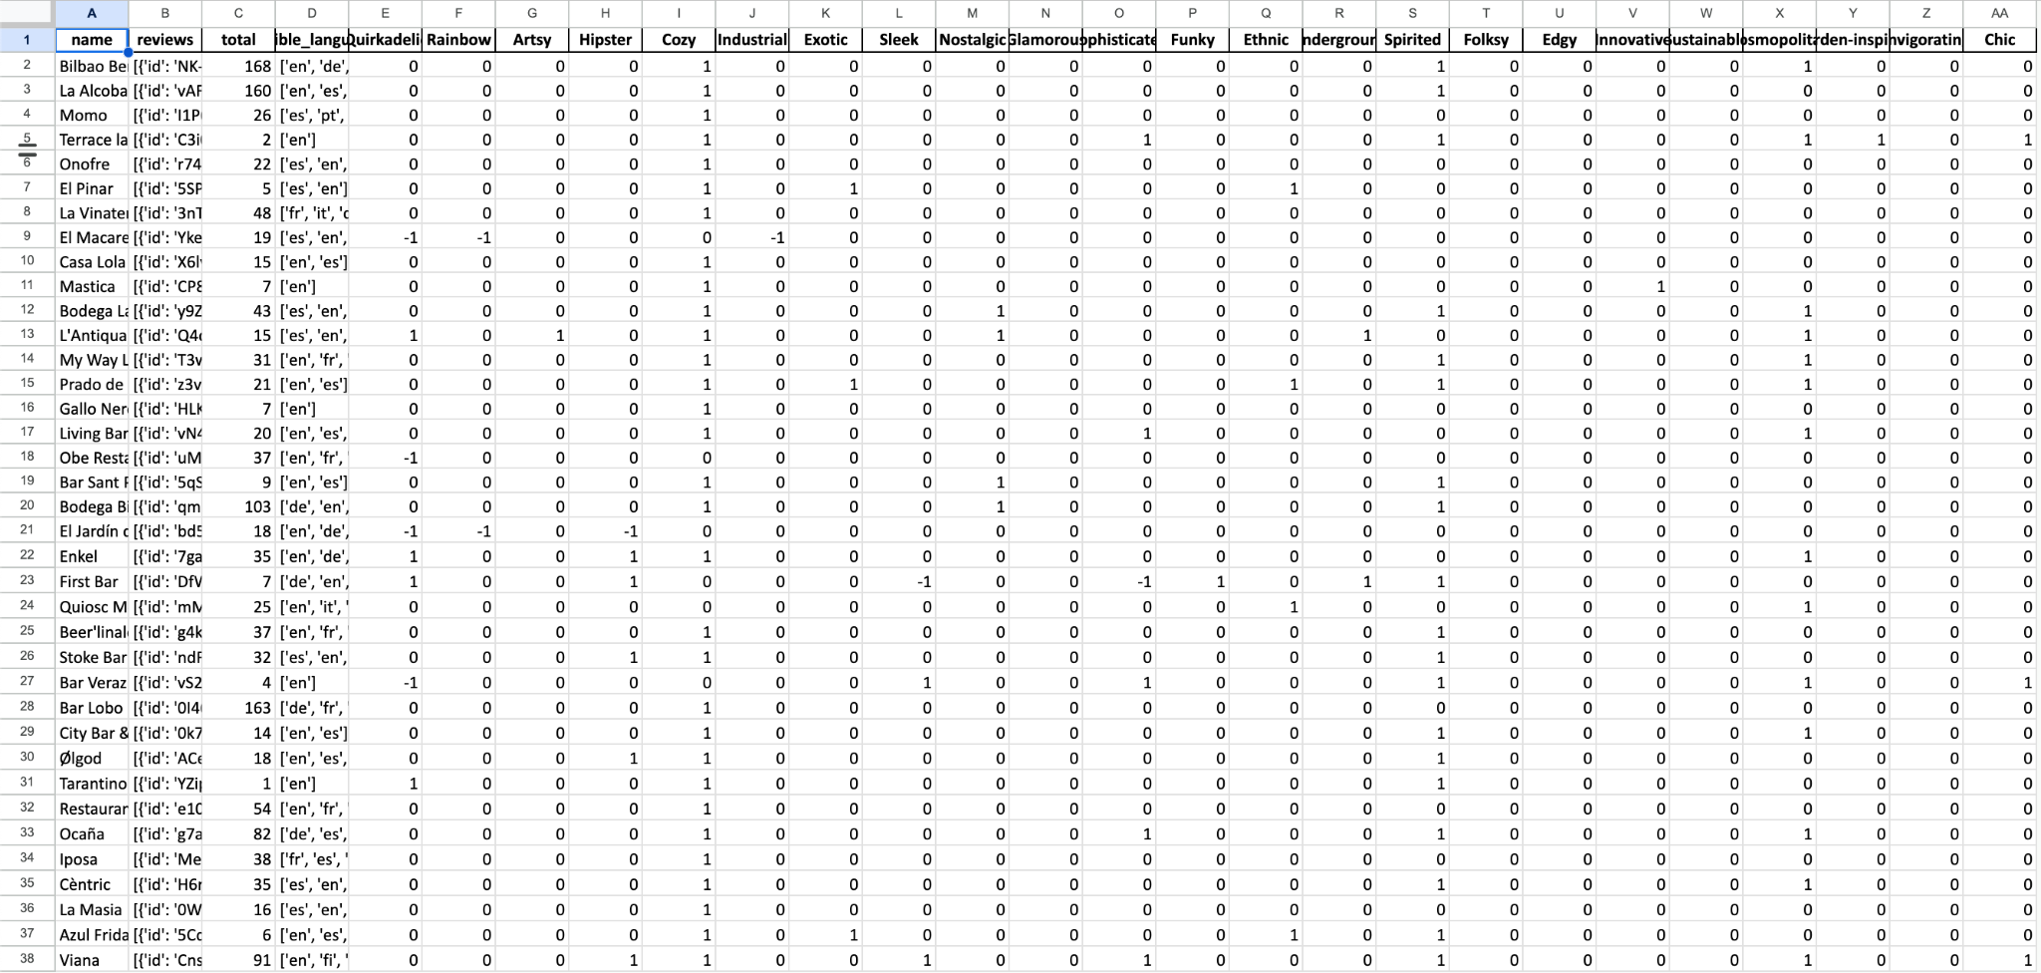
DEEP DIVE
Notes:
• detailed presentation of results (e.g. in-depth explain one or two clusters to demonstrate method and practical outcome)

Slide 15
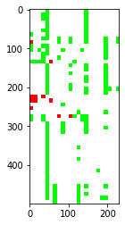
DEEP DIVE
KNN RESULT: CLUSTERING ANALYSIS
While results look meaningful when analyzed in isolation,
Clustering and visualizing the resulting dataset shows that GPT introduces significant biases in the data.
Enlarge dataset with more examples and more review text
Identify features that aren’t informative (such as “cozy” in the example) and either improve classification for this feature or remove it from the vectors
Notes:
K-means, GPT tends to predict some vibes more than others.

Slide 16
OUTLOOK & ROADMAP
Vector accuracy improvement
PROBLEM: Right now "SLEEK" and "CHIC" are orthogonal, which means there is no information shared between them. If we have restaurant that is SLEEK (but not labeled as CHIC), and the user is looking for something SLEEK the CHIC label should count for something.
SOLUTION: This can be addressed by using GPT embedding vectors for each vibe
PROBLEM: Unreliable data labeling
SOLUTION: This can be addressed by nudging users to submit feedback ("was this place 'Awesome'?")
App function improvement
Input: Image + test prompt

Slide 17
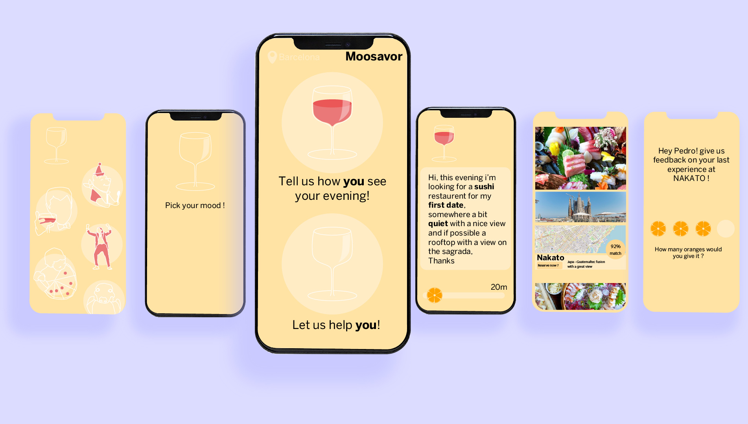
MOCK-UP

